Slide 1
The Fun Formula
By Alissa Sherbatov

Slide 2
Project Description
The project will attempt to find a formula for roller coaster engineers to prevent G-LOC (Gravity- Induced Loss of Consciousness) in their designs, as well as a way to figure out if a rollercoaster could cause G-LOC. I will study and research on how engineers figure this out in today’s roller coasters, and see if a formula can be created. This potential formula could become an essential shortcut and safety measure for today’s engineers.

Slide 3
Background of Project
My hypothesis is, yes, a formula can be created. However, it will be pretty complicated, so I plan on reading textbooks and journals on G-LOC or reaching out to a few roller coaster engineers. Some potential variables are- the size of the loop (or drop), the radius of the loop, the angle of the loop from the ground, and how much G-force the coaster will have.

Slide 4
What’s the G-Force Limit?
The first thing I researched was how much G-force is enough to knock someone out of consciousness. I found that this is partially dependent on the time the person spends exposed to this G-force, and not necessarily the number of G’s itself. Instead, I chose to base my calculations on the highest G-force on a roller coaster in the United States, 5.9 G’s (from the Shock Wave coaster in Six Flags Over Texas).

Slide 5
Actually Finding the G-Force
I learned that, to find G-force, many variables are at play, and acceleration has to be found beforehand. I then ran into my first problem- I realized I’d have to use different formulas for roller coaster drops and roller coaster loops (not to mention twists, corkscrews, and all other special exceptions). I chose to start with loops. I found out that 1 G is 9.8m/s², and the formula for G-force (generally speaking) is (g+a)/g (where g is for gravity, which I will round to 9.8m/s²). As for the acceleration in a loop, the centripetal acceleration formula would have to be used.

Slide 6
Centripetal Acceleration
Simply put, centripetal acceleration is the acceleration of an object moving in circular motion. Even if an object is moving at a constant magnitude of speed, it is changing direction as well (since it is moving around the circle), and since velocity is a measure of magnitude and direction, the object is technically accelerating. At a constant speed, the centripetal acceleration formula is a= v²/r (v being initial velocity, r being radius or distance from center of circle). However, due to gravity, the velocity will be far from constant. And, of course, roller coaster loops are never fully circular, so which radius is the right one? The radius problem could be solved by either taking multiple trials of the acceleration at different points of the circle, or finding out at which point the acceleration would theoretically be the biggest.

Slide 7
Where Is G-Force Highest?
Since the goal is to create a formula (or at least get as close to a formula as possible), finding out where on the loop the maximum acceleration would be is the best option. After some research, I found that the computer game Roller Coaster Tycoon 2 (where roller coasters can be viewed and designed) has a G-force measurer for when the designed coasters are put into simulation. I wanted to play the game and experiment with different radii and initial velocities to see where that G-Force meter showed the biggest number. Of course, I’d have to prove after why this is so, but I thought conducting an actual experiment first would be pretty fun.

Slide 8
More Coaster Video Games
At this point in research, I was getting ready to buy the program when I realized that I have an Oculus Rift at home, which I already had a lot of video games for. One of them was NoLimits 2, the whole purpose of which is to make roller-coasters and view and simulate premade roller-coasters. There is a G-force meter there also. Come to think of it, this is the very game that got me so interested in roller-coaster design, way back when I was 10. But anyways, I need to make my prediction for when I think the G force would be highest, which I’m thinking would be at the beginning of the loop as it just starts to curve (moreover, if this were true, I wouldn’t need to worry about some of the problems with centripetal acceleration and other circular motion physics that I’d run into earlier).

Slide 9
A Computer Game Experiment
After setting up the game, I figured I’d need a data chart to organize possible variables and outcomes. So here is a data chart with all of my results:
Name of Coaster | Radius of loop | Tightness of loop (.3 is typical teardrop shape, 0 is fully round, loop untwists as number increases) | Location of highest G-force
FF-1-10-0 | 10 | 0 | Start of loop
FF-2-10-03 | 10 | 0.3 | Start of loop
FF-3-14-0 | 14 | 0 | Start of loop, end of loop*
FF-4-14-03 | 14 | 0.3 | Start of loop
*since the loop is symmetrical this doesn’t affect the results and all of the properties would be the same but in the other direction

Slide 10
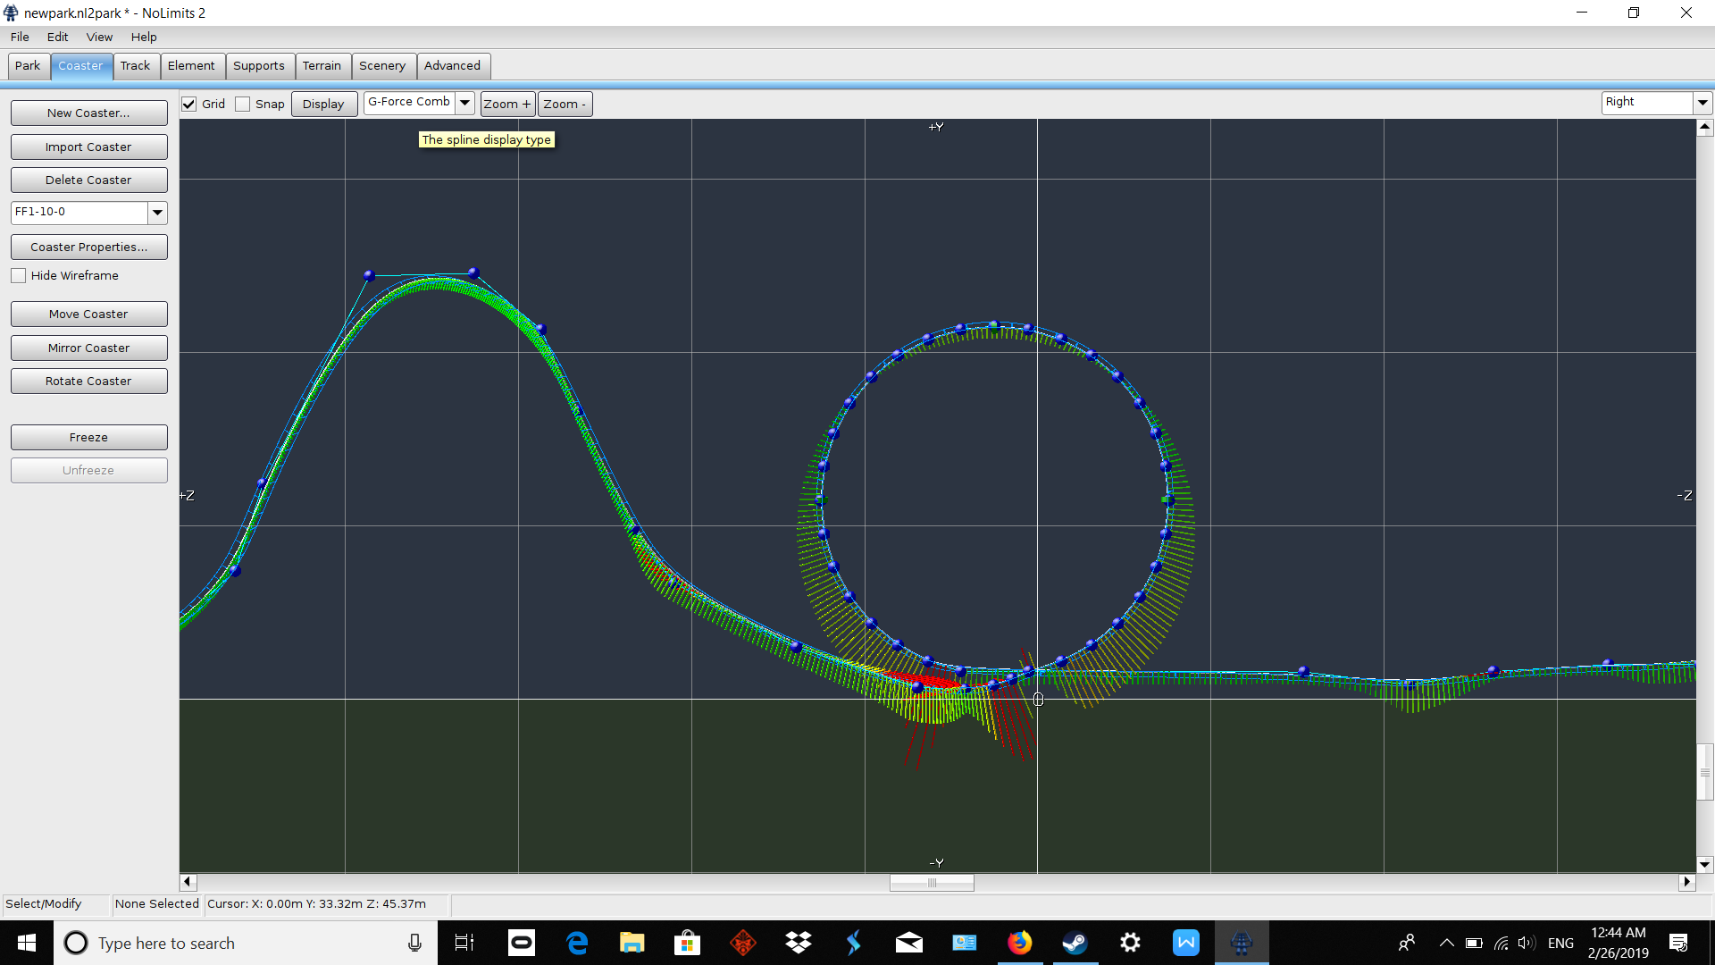
Screenshots of the Coasters
Roller-coaster: FF-1-10-0
Radius: 10
Tightness: 0
(Green is the least G-force, red is most)
Highest G-force: at start of loop

Slide 11
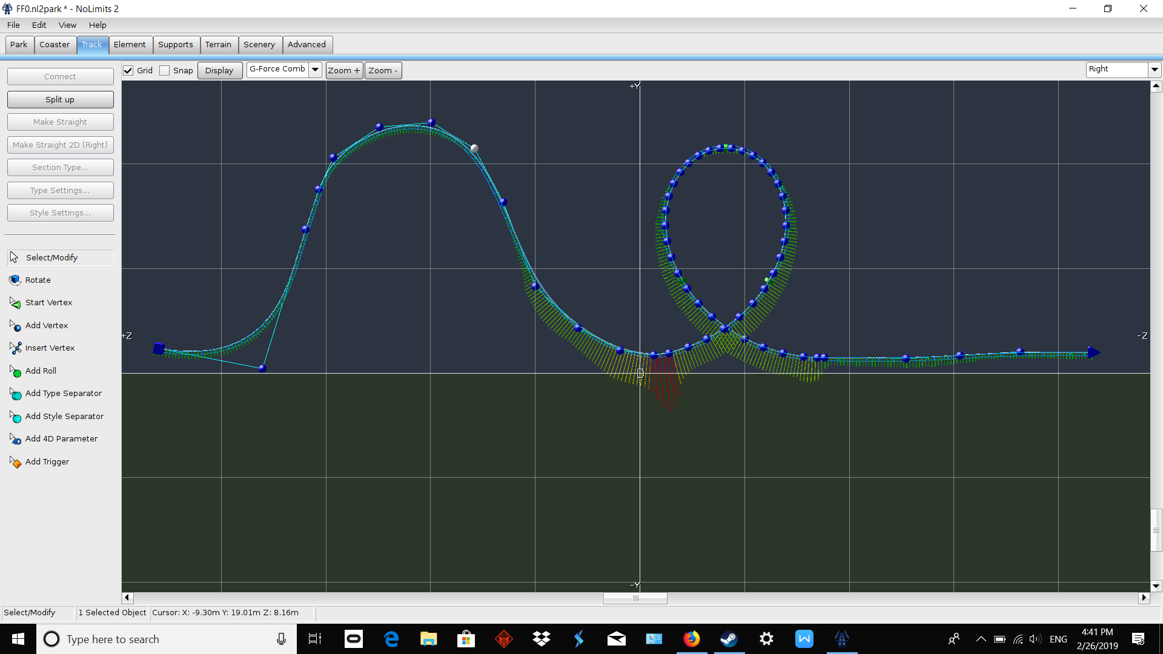
Screenshots of the Coasters
Roller coaster: FF-2-10-03
Radius: 10
Tightness: 0.3
Highest G-force: at start of loop

Slide 12
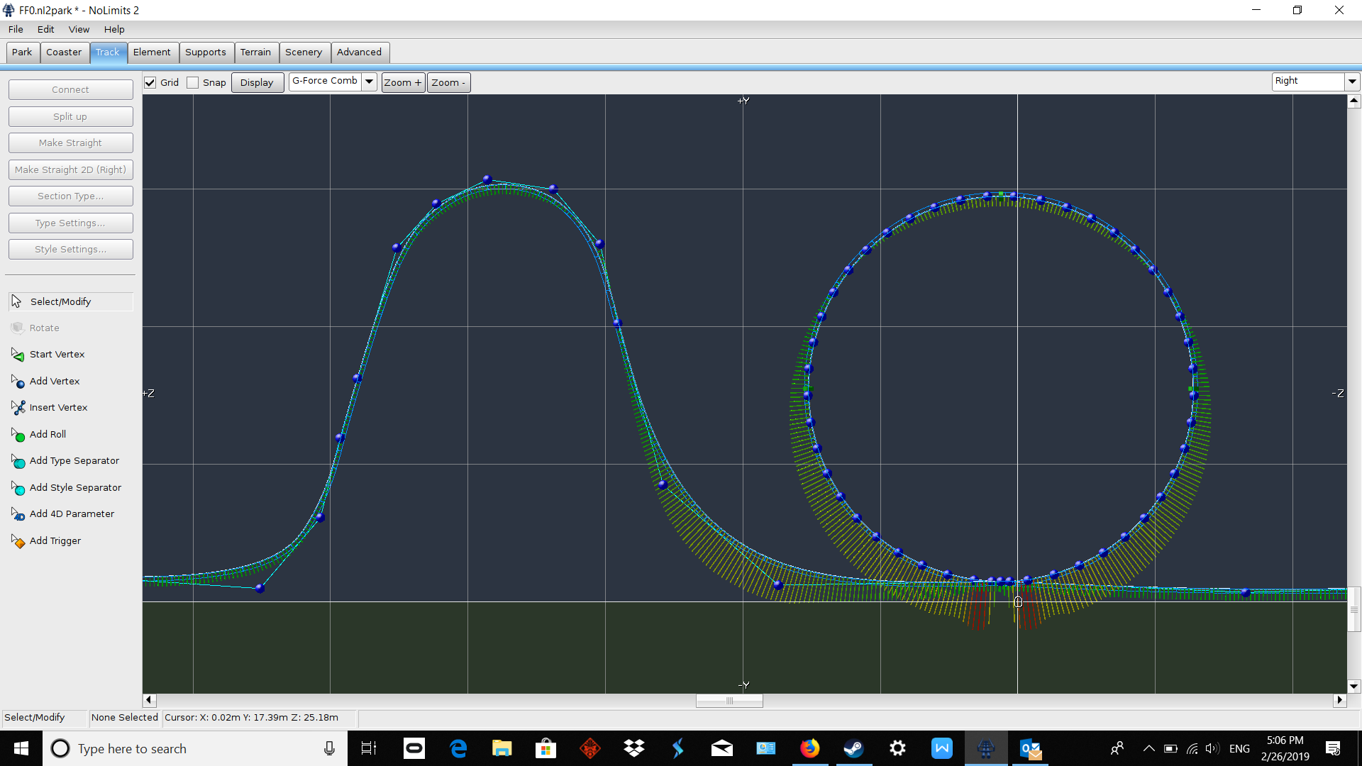
Screenshots of the Coasters
Roller coaster: FF-3-14-0
Radius: 14
Tightness: 0
Highest G-force: at beginning and end of loop

Slide 13
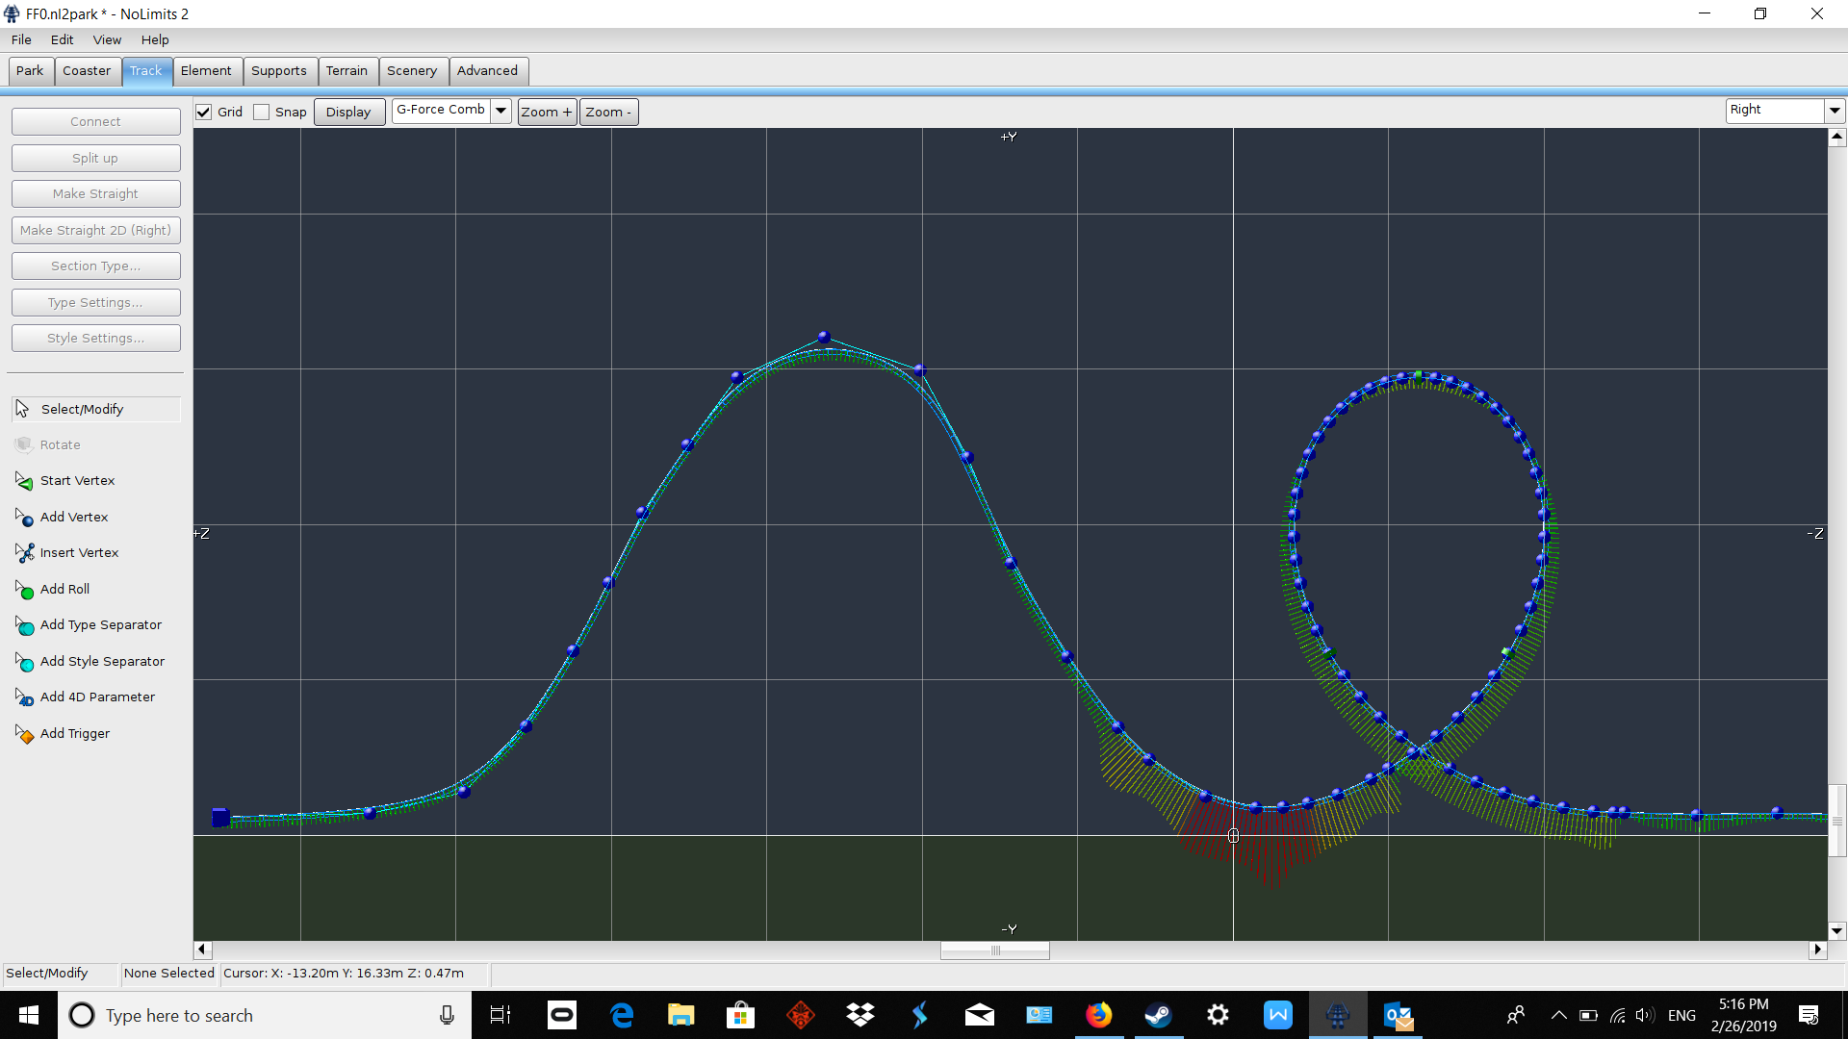
Screenshots of the Coasters
Roller Coaster: FF-4-14-03
Radius: 14
Tightness: 0.3
Highest G-force: at beginning of loop

Slide 14
Making Some Conclusions
Through experimenting by building roller coasters in Oculus Rift NoLimits 2, I found that the highest G-force in a loop is seen at the very beginning of the loop. This makes the job of pinpointing a formula a bit easier since circular motion and centripetal acceleration don’t come as much into play. However, I still had to figure out the initial acceleration and velocity after the drop that leads into the loop.

Slide 15
But Why Is That So?
I did say I was going to explain why the G-force is highest at the bottom of the loop. The answer is simpler than it seems.
Looking at the formula for centripetal acceleration, we can see that velocity is a key component in it. Because of gravity, the roller coaster would lose speed as it works its way up the loop, and although velocity is symmetric (or basically, at a certain quantity away from the top of the loop, the negation of the velocity going up from the top is the velocity going down from a top since the acceleration is the same), friction will make the coaster slower as it moves about the track. So, the biggest acceleration happens at the bottom of the loop.

Slide 16
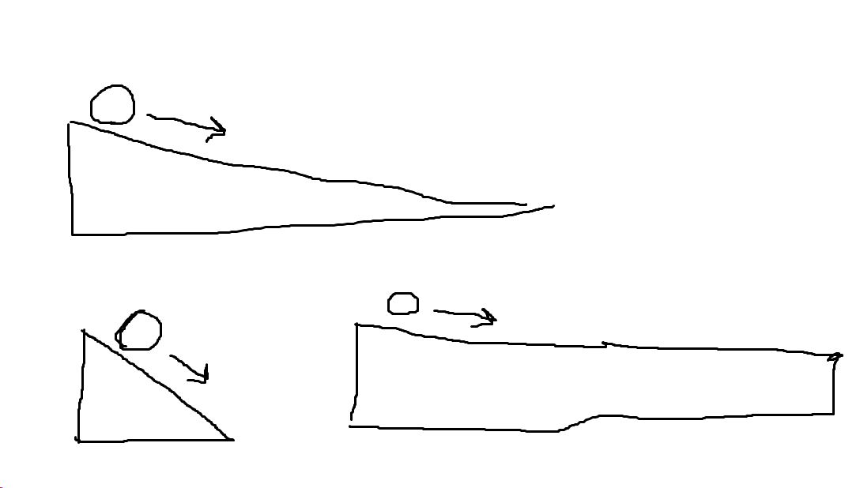
A Similar Situation
To understand the situation, let’s consider a ball rolling down a ramp.
All 3 ramps will give the ball different final velocities and times. This situation is identical to a roller-coaster car going through a drop- the steepness of the drop affects many things, so a formula is required to link steepness and velocity (taking height into account).

Slide 17
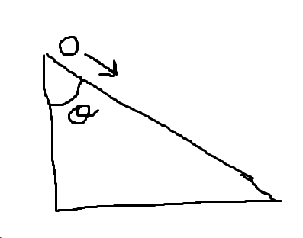
Inclined Planes
Essentially, a roller coaster going down a drop is like a ball rolling down an inclined plane or some sort of ramp. So, all I needed to do was find the acceleration of an object for that particular plane. And, as it turned out, the answer was right in front of me- my current physics class unit on forces. Essentially, all I had to do was draw some free body diagrams and calculate the force on the roller coaster going down the drop. As for the angle to the inclined plane, some simple trigonometry could be used. I’ll explain the process of finding acceleration all on the next slide (and for the sake of simplicity, let’s assume no friction until later on).

Slide 18
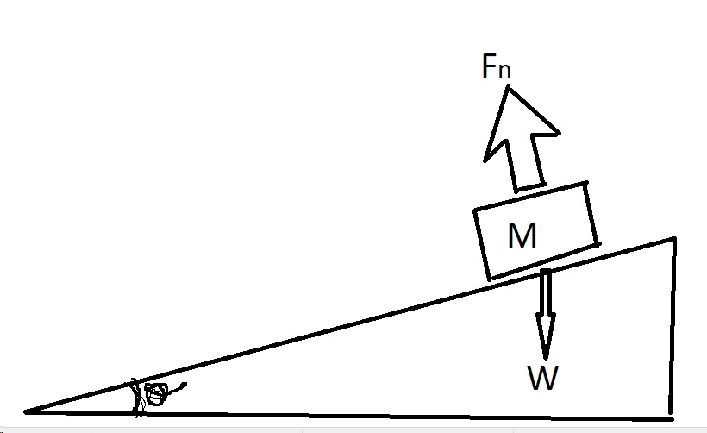
A Forces Crash Course
Drawings don’t exactly turn out the best in MS Paint, but yes, the angle in the bottom-left corner is supposed to be a theta sign.
Pictured is an inclined plane with angle/steepness theta, and an object with mass M, as well as the forces acting on it. Its weight, or mass times gravity (w=mg or w=9.8m) is pulling downwards towards the earth, unaffected by the incline of the surface. However, Fn (or the object’s normal force, which pulls it up*) supports the object at an angle, as the surface which is supporting the object is itself at an angle (relatively to the ground). So, how are forces calculated with an angle involved? The answer is trigonometry.
*To best explain normal force, let me put it this way- normal force is what keeps an object on, say, a table, instead of said table collapsing. The object applies the force of its weight on the table, and the table in return applies normal force to keep the object on the table. If you want to think of it in terms of Newton’s 3rd law, weight is the action and normal force is the reaction.

Slide 19
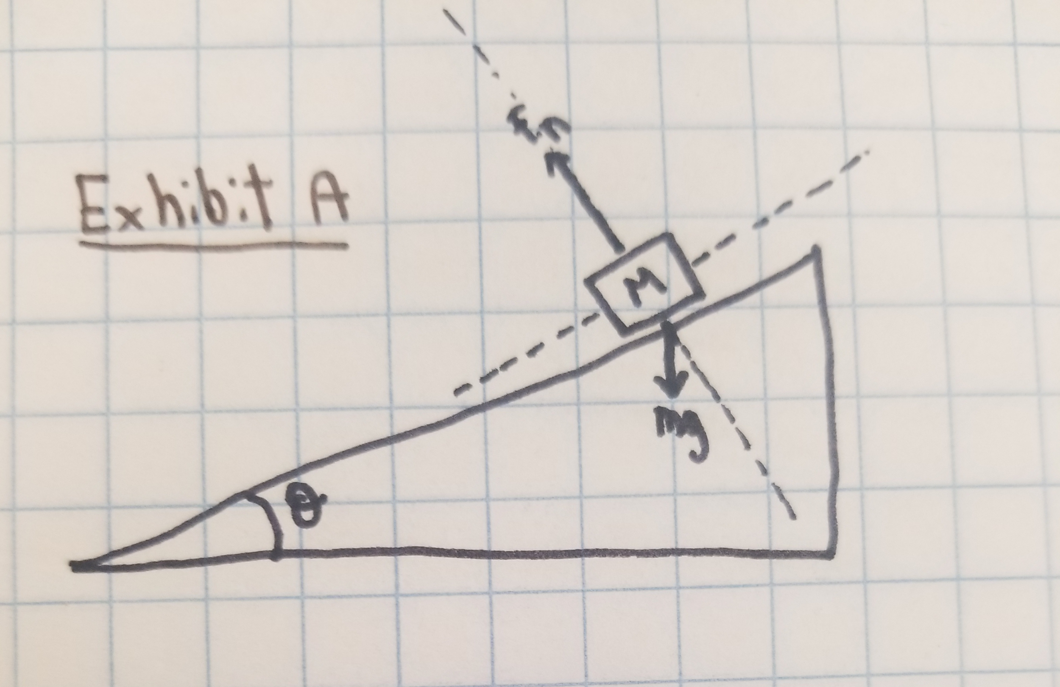
Inclined Planes Exhibit A
At this point, MS Paint became a detriment, so I had to write out the work on paper and split it up into exhibits.
The best strategy to map out the forces acting on an inclined plane is to put the object at the center of some sort of Cartesian plane (split up into the 4 quadrants as I’ve shown). Now, if you turn the plane right side up like it’s supposed to be, the object will lose its incline.

Slide 20
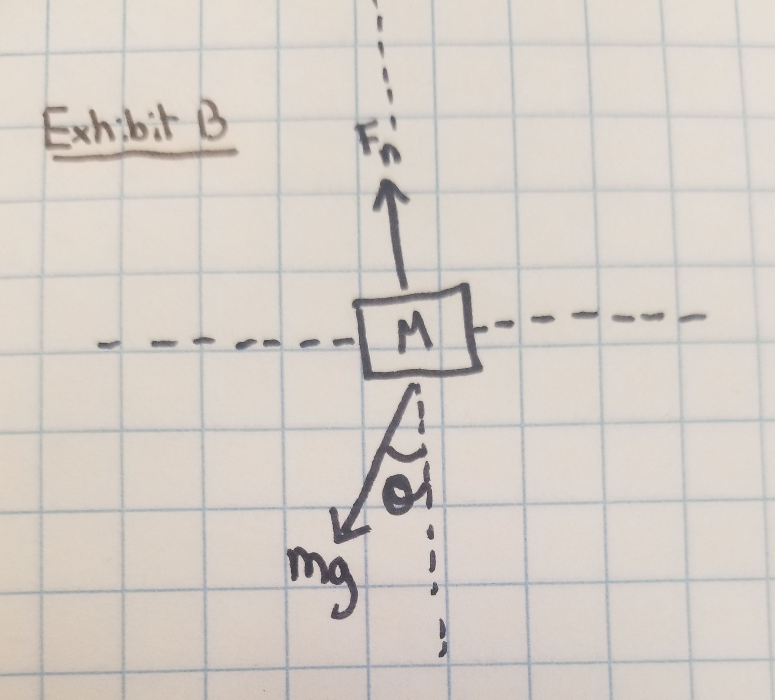
Inclined Planes Exhibit B
Now that we’ve turned the object on its right side, we can see that weight is acting in theta degrees (also the angle of the incline itself)- we know that these angles are the same because theta is just the difference between level ground and the incline. That’s exactly what this is.

Slide 21
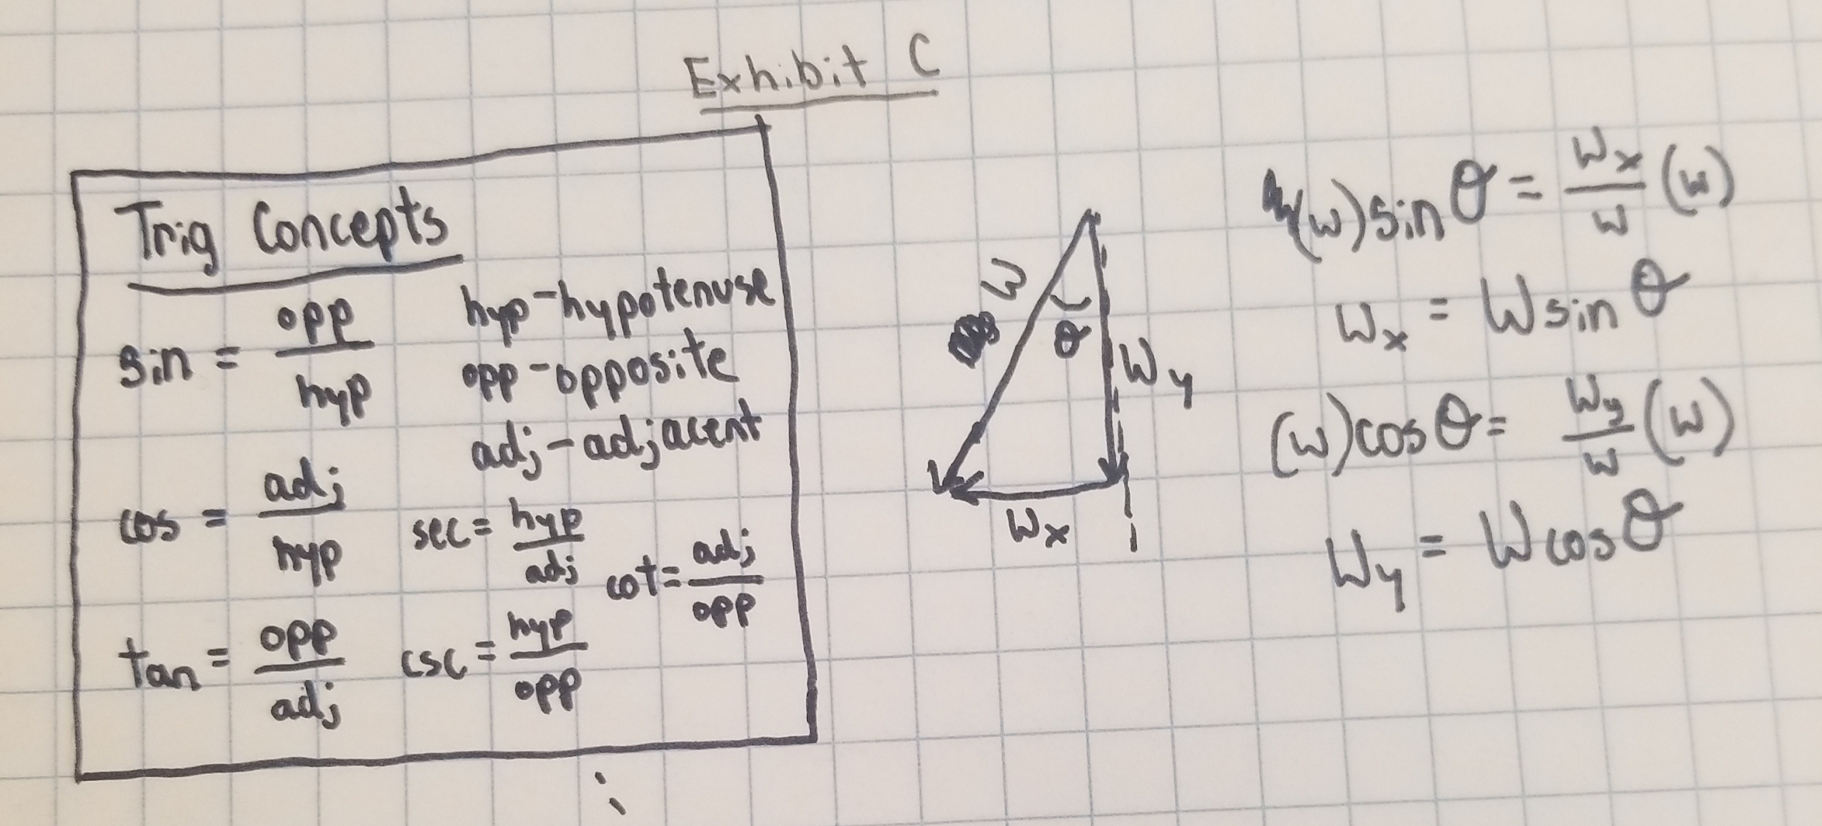
Inclined Planes Exhibit C
We can now split mg, which I’ll now call W or weight, into x and y components. We can determine these through some simple trigonometry as shown in the picture.
X-component: Wx=W(sintheta) Y-component: Wy= W(costheta)

Slide 22
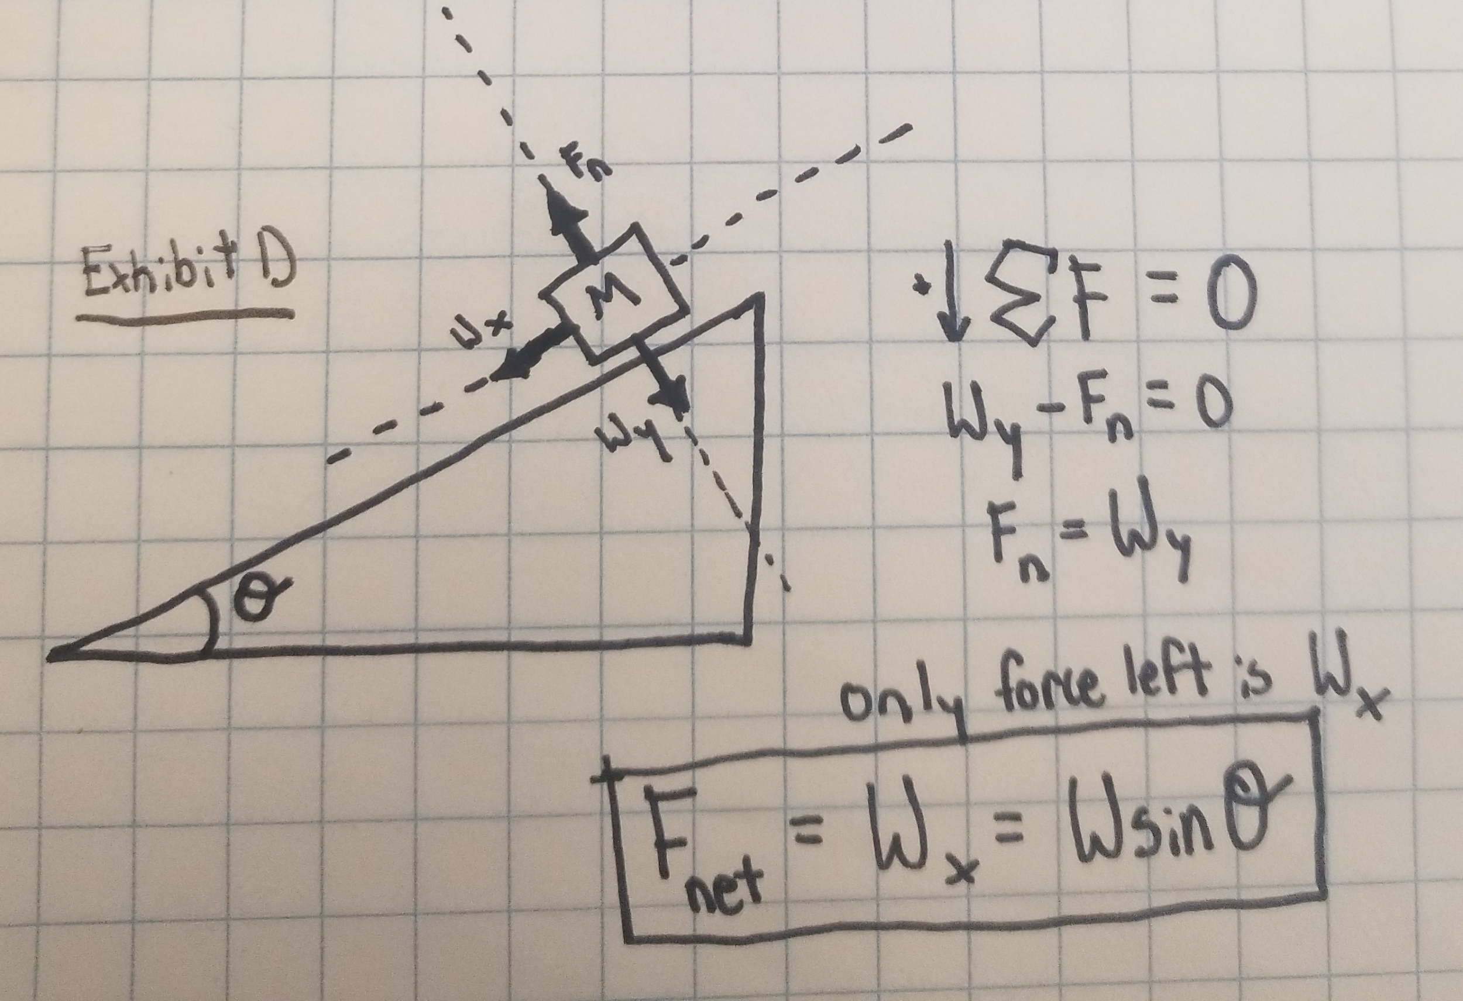
Inclined Planes Exhibit D
We now have to look at this diagram in the view of the plane surface (that the object is moving on), and not the ground. Respectively to that surface, it is clear that the object is not moving vertically, meaning that the sum of all the vertical forces is 0 and Wy= Fn. The only force left (other than friction and air resistance which we are neglecting right now) is Wx, so the net force is Wx or mg(sintheta).

Slide 23
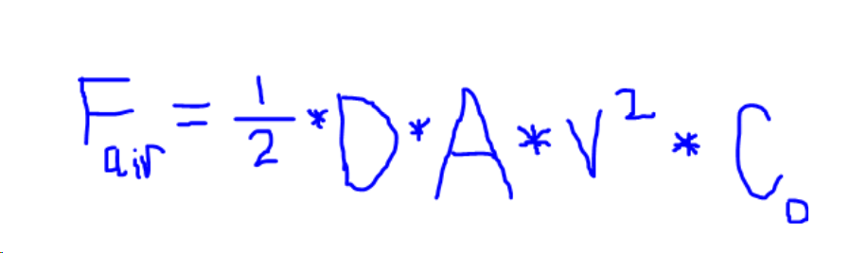
But What About Air Resistance?
We neglected friction, but it’s relatively easy to put back into the formula. Air resistance, however, is much harder (and it doesn’t affect a roller coaster that significantly so we’ll be neglecting it in our formula). The formula for air resistance is:
In the next slide, I will explain what all the variables signify.

Slide 24
So What Does All That Mean?
Side note- I won’t be including air resistance in my final formula, since there are many other components to the formula and air resistance isn’t significant enough to be worth the long process of calculating it. Right now I’ll just be explaining all the coefficients.
D- the density of the air. At STP, or Standard Temperature and Pressure (15 degrees Celsius at sea level), D is 1.225kg/m3 (kilograms per cubic meter).
A- the cross-sectional area of the object (or in the case of a roller coaster, only the area/data of the 1st cart is taken into account since that is the area that the air is affecting)
Cd- the drag coefficient. For a roller coaster this is the hardest variable to calculate since a drag coefficient can’t be theoretically calculated. It has to be based off of experimental values. However, the shape of a roller coaster (as the shape affects the drag coefficient) is somewhat similar to that of a passenger train, so that can be a proper substitute.
V- the velocity at the time that the air resistance is being calculated.

Slide 25
Accounting for Friction
We will still be neglecting air resistance for the formula, but friction is an easy force to account for since it naturally acts parallel to the inclined plane (unlike something like gravity or air resistance). The next step after figuring out the direction is actually calculating the friction. There are 2 main types of friction- static and kinetic (or sliding). A roller coaster going down a drop is affected generally by kinetic friction, as the car is “sliding” down the rollercoaster. The formula for kinetic friction is Fk= μ_{k}*Fn. μ_{k} is the “kinetic friction coefficient”, which is determined by what materials are sliding against each other, and if the materials are wet or dry. Fn is the normal force (usually mg(costheta) in inclined planes). The kinetic friction coefficient is different for each combination of materials (a roller coaster is usually made of steel, its car of aluminium or fiberglass, and the wheels of polyurethane or nylon). Simply subtract friction from the current net force to get F_{net}=mgsintheta-μ_{k}Fn= mgsintheta-μ_{k}mgcostheta.

Slide 26
Putting Some Pieces Together
Since F=ma (force= mass*acceleration), a= F/m. We know that the net force is (mgsintheta- U_{k}mgcostheta), so a= (mgsintheta- U_{k}mgcostheta)/m= gsintheta- U_{k}gcostheta (remember that g= gravity on Earth= 9.8m/s²).
Now, to find the centripetal acceleration, a velocity is required. We can use the simple formula v= v₀+ at (v is initial velocity, t is time, v is final velocity) and plug in the acceleration to find final velocity as v₀+ (gsintheta- U_{k}gcostheta)(t). Now, plugging that into the centripetal acceleration formula, we get:
a_{c} = (v₀+ (gsintheta- U_{k}gcostheta)(t))²/r. Now plugging THAT into the G-force formula (which simplifies to 1+(a/g)), we finally get our formula:
G-force= 1+((v₀+ (gsintheta- U_{k}gcostheta)(t))²/r)/9.8

Slide 27
So What’s the Big Picture?
Now, it doesn’t take a genius to figure out that this formula is not the most appealing to use when put in such an extended form. This formula would only work, also, for an inclined plane into a loop, and although this exact format does work for many roller coasters, many have different features in them that can bring about a completely different G-force. So, can a formula be created? Yes, it can. But is this formula effective to use? Not really. Even if your coaster falls into the strict inclined-plane-loop type of roller coaster, the coaster car is lying flat down on the track (unlike one of those hanging Talon coasters), AND you don’t mix up the parentheses of this very convoluted formula, this formula would only inconvenience your G-force calculations!
So, what is the right way to calculate the G-force of a roller coaster, if not by the means of a single formula? Well, if the coaster doesn’t fit into this basic type of ride, an inclined plane into a loop, the forces need to be mapped out. Once there is a net force figured out, the acceleration can be found, and so on. In such a long calculation, it is important to consider each type of coaster individually, and take the calculations one step at a time (assuming there are no unknowns, at least). Then you’re good to go, with a formula or without.

Slide 28
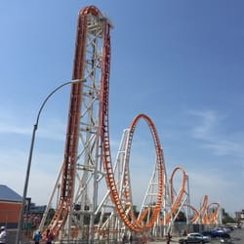
Is There An Example?
As one of the concluding aspects of this project, I thought it would be fun to test some of these formulas out. What if I could go to an amusement park and measure a roller coaster’s G-force in two ways, once with a phone app utilizing the phone accelerometer, and once with physics formulas? That’s exactly what I’m going to do in the next few slides. I picked out the Thunderbolt roller coaster at Luna Park in Brooklyn for this task for a few reasons, but mostly, the generic-ness of the roller coaster makes it very easy to demonstrate some physics at work. Besides, a lot of the required data would be really easy to measure while riding it.

Slide 29
What’s the Plan?
I could’ve connected an accelerometer to an Arduino, or bought a sensor off of PASCO. But the simplest way to measure acceleration, I figured, was through an app on my phone (two apps, to be specific- one accelerometer and one altimeter). I will secure my phone in a zipped jacket pocket while the apps are running, and use a screen recorder to view the data afterwards. I will also make a data chart of times, altitudes, and G-forces at certain points of the coaster.

Slide 30
So, here is the data chart:
Point of coaster | Right before drop | Start of loop/ end of drop | Top of loop | End of loop
Time | 0m46s | 0m49s | 0m51s | 0m54s
G-force | .94G | 4.95G | 0.08G | 4.41G
Altitude | 115m | 2m | 100m | 2m

Slide 31
Figuring Out the G-force via the Formula
Since the whole point of the project was to come up with a formula, I’ll be using my formula for the calculations. Just as a refresher, the formulaI came up with was: 1+((v₀+ (gsintheta- U_{k}gcostheta)(t))²/r)/9.8. However, since we know that the Thunderbolt’s drop’s incline is 90 degrees, and the cosine of that is 0, our formula simplifies to 1+((v₀+ (gsintheta)(t))²/r)/9.8. At least now finding the friction coefficient isn’t a concern. Also, a fair assumption to make for this particular rollercoaster is that the initial velocity at the top of the is 0. Since the sine of 90 degrees is 1, the time from top to bottom of the drop is about 3 seconds, and the radius is (100-2)/2=49m, G-force= 1+((0+ (9.8)(3))²/49)/9.8= 1+1.8= 2.8G
What could account for the moderate offset? Possibly, hypersensitivity of the G-force app, or not enough detail on drop time, or some completely different offset. Either way, the formula got us reasonably close to the experimental G-force, so theoretically, and with a much better means to measure acceleration and time, the formula would work.

Slide 32
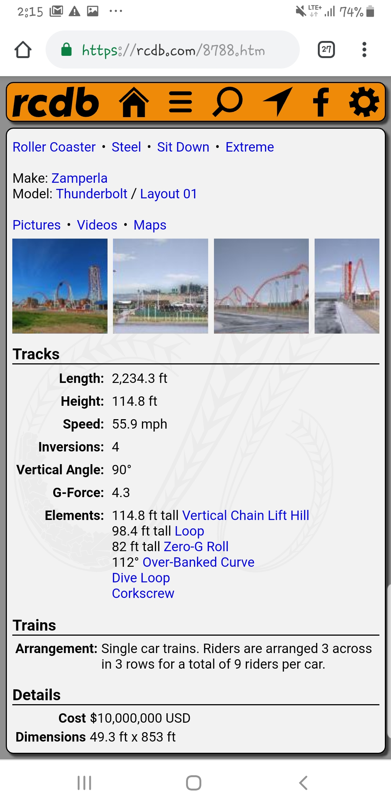
Was Either Measurement Right?
This RCDB (Roller Coaster Database) entry states that the coaster’s G-force is 4.3, so the G-force app was definitely a bit hypersensitive. The accelerometer was slightly more accurate.

Slide 33
Today’s Roller-Coaster Engineers
So, just how do roller-coaster engineers and professionals ensure that a coaster is safe? There are many types of engineers that fit into this. Mechanical engineers design loops, drops, and any other part that needs designing. Structural engineers focus on structural aspects of the coaster (think support beams). Electric engineers and programmers design programs to ensure that no roller-coaster car leaves too late or too early- essentially, they write the programs that make roller-coasters go smoothly and efficiently. In general, lot of time is spent on safety, as well as drawing various free-body diagrams to show forces acting on the coaster car in a different part of the coaster (top of drop, top of loop, just entering a corkscrew, etc). So, it’s clear that, although it can pique and expand our understanding of physics and roller-coasters, no one formula can replace the profound art that is roller-coaster engineering.

